Slide 1
Management of Gastrostomy & Jejunostomy tubes

Slide 2
Aims of session
Types of tube
Care and maintenance
Complications- prevention and treatment

Slide 3
Types of gastrostomy
PEG- Percutaneous Endoscopic Gastrostomy
Replacement gastrostomy (balloon)
Low profile or “Button” gastrostomy (balloon)
RIG- Radiologically inserted gastrostomy

Slide 4
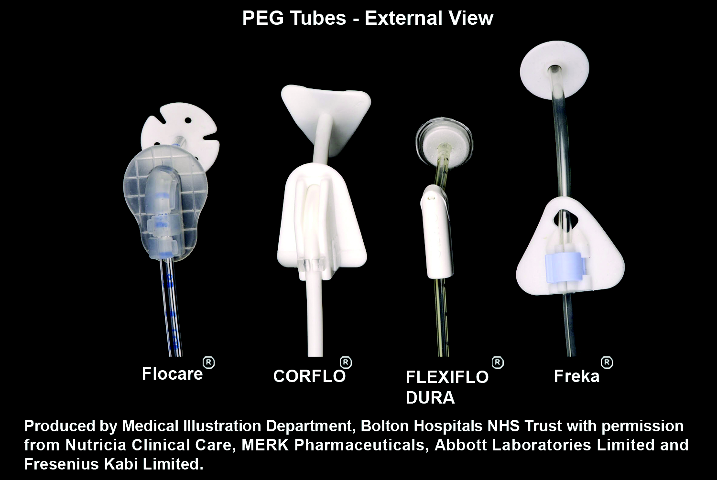
PEG
Inserted endoscopically
Have an internal and external fixation device

Slide 5
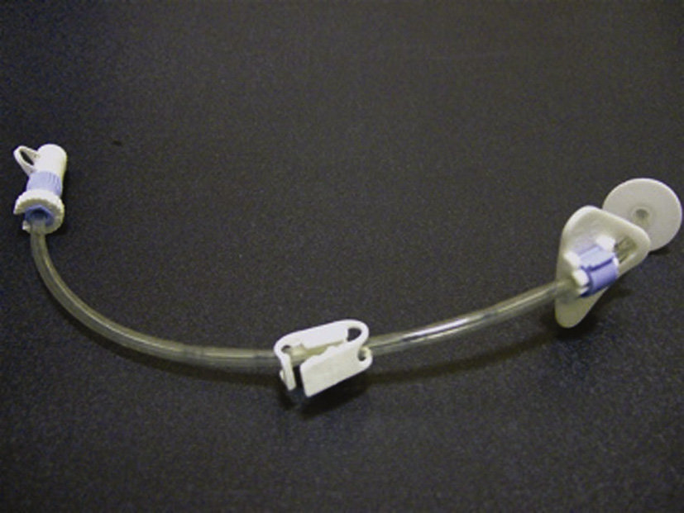
Freka Gastrostomy tube

Slide 6
Care of PEG- (first 2 - 4 weeks post insertion)
Clean stoma site with sterile water and dry thoroughly
Do NOT open external fixation device, but ensure cleaned thoroughly
Dressing is not usually needed after 24hrs
Do not submerge stoma in water

Slide 7
Routine PEG care
Daily
  Clean stoma with mild soap and water and dry thoroughly
  Observe for signs of infection/inflammation
  Keep outer surface of tube clean
  Rotate the tube 360⁰
  External fixation device may be unclipped and cleaned then returned to correct position
  Flush tube regularly
Weekly
  Unclip external fixation device, advance tube into stomach by about 4cm. Return to correct position

Slide 8
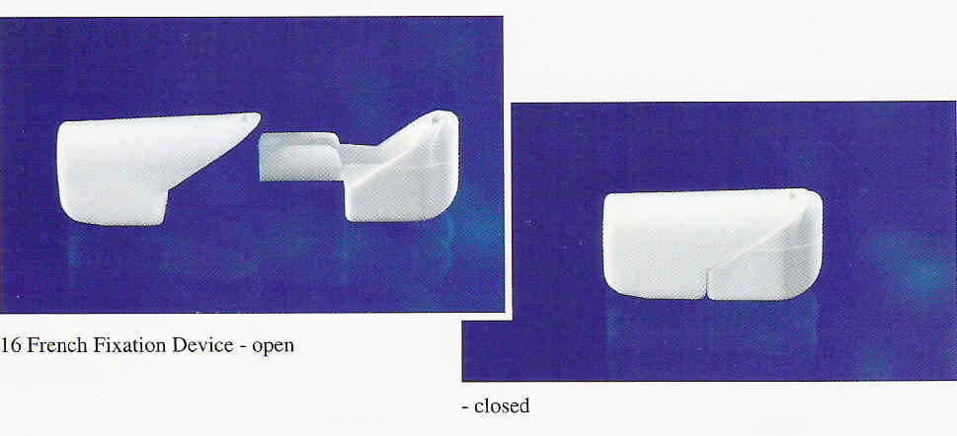
Advancing and rotating the tube
Weekly:
Open fixation device and move up the tube, away from the stoma
Push tube into abdomen by about 4 cm
Pull back on tube until resistance felt i.e. internal fixation against stomach wall
Close fixation device and position 2-3mm from skin

Slide 9
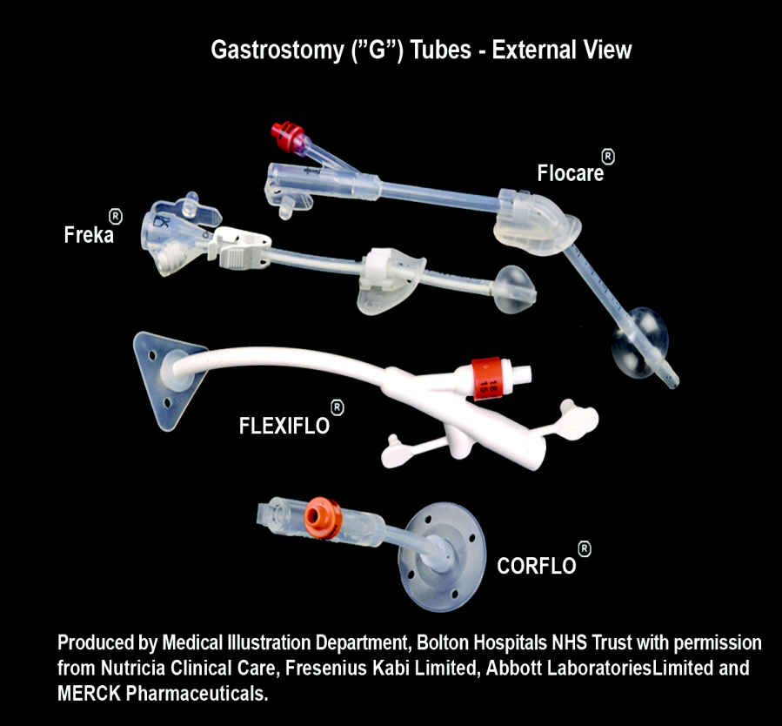
Balloon Gastrostomy tube
Internal balloon
Replace 3-6months
No clamp

Slide 10
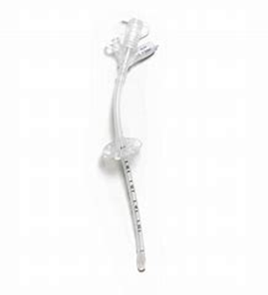
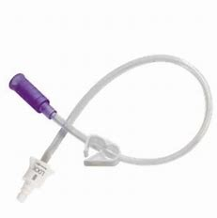
MIC replacement balloon gastrostomy and extension set

Slide 11
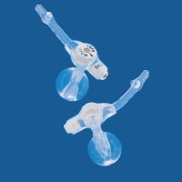
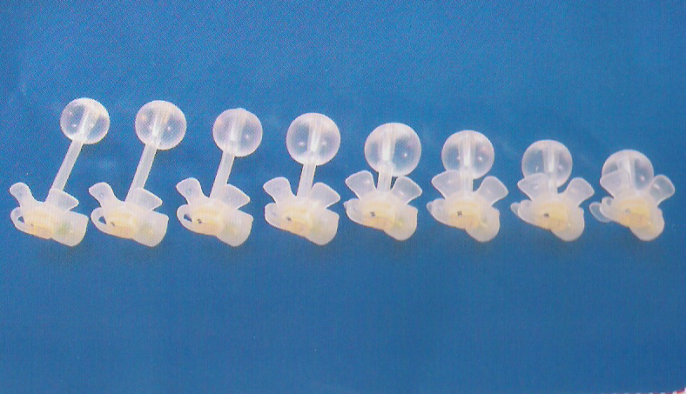

Low profile gastrostomy
Internal balloon
Replace 3-6months
Need to know length of stoma tract
Popular with children or young adults
Requires an extension set for feeding

Slide 12
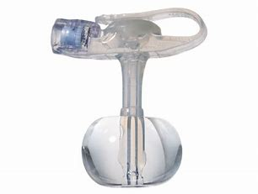
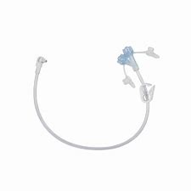
AMT minion low profile gastrostomy
MIC extension set Enfit

Slide 13
Routine care of a balloon gastrostomy
Daily
  Observe stoma daily for signs of swelling, leakage, redness, soreness or infection
  Wash with mild soap and water and dry thoroughly
  Rotate tube 360º
  Check the position of the external fixation device
Weekly
  Check the balloon integrity

Slide 14
Checking balloon integrity
Discontinue feeding
Use a syringe to remove water from the inflation port
Make a note of the volume removed
Re-inflate the balloon with correct volume of fresh water
If concerned there is a leak in balloon, consider tube replacement

Slide 15
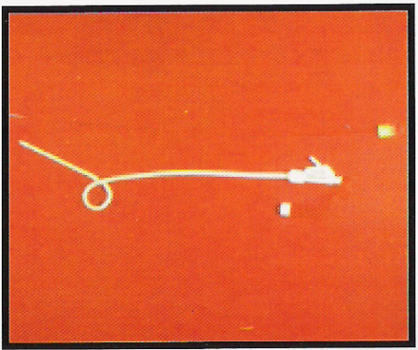
RIG
Radiologically Inserted Gastrostomy
Indications- Head and Neck Cancer, MND
Tend to last up to 6 months
Balloon/ “pigtail” tube
May be sutured

Slide 16
Routine RIG care
Daily
  Clean stoma with mild soap and water and dry thoroughly
  Observe for signs of infection/inflammation
  Keep outer surface of tube clean
  DO NOT rotate the tube 360⁰ (unless advised to do so by your Dietitian)
  Flush tube regularly
Weekly
  Check with your Dietitian.

Slide 17
Immediately Post Placement of any tube
The following require IMMEDIATE medical attention
Pain during feeding or medication delivery
Significant pain or distress after the procedure
New bleeding from the stoma site
Leakage of fluid around the tube
In the event of any one of these symptoms, the following action MUST be taken
Stop feeding / medication delivery immediately
Seek immediate medical advice

Slide 18
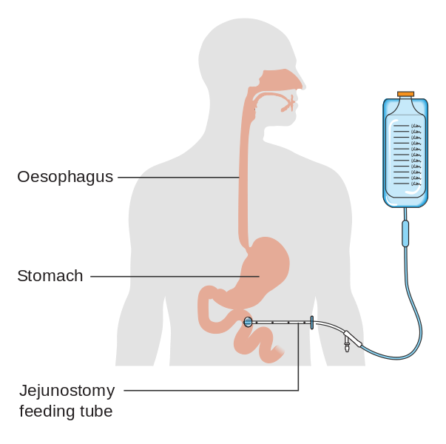
Jejunistomy Feeding

Slide 19
Surgical Jejunostomy
Inserted surgically
Long term

Slide 20
Routine care
Daily
  Clean stoma with mild soap and water and dry thoroughly
  Observe for signs of infection/inflammation
  Keep outer surface of tube clean
  DO NOT rotate the tube 360⁰
  Flush tube regularly

Slide 21
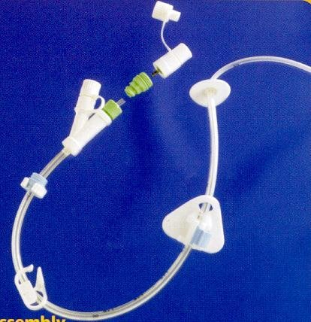
PEG-J
Jejunal extension passed through PEG tube
Ports are marked “I” and “G”
Long term

Slide 22
Routine care
Daily
  Clean stoma with mild soap and water and dry thoroughly
  Observe for signs of infection/inflammation
  Keep outer surface of tube clean
  DO NOT rotate the tube 360⁰
  Flush tube regularly
Weekly
  Unclip external fixation device, advance tube into stomach by about 2-3cm. Return to correct position

Slide 23
For each patient
Record type of tube in situ
  Gastrostomy
  Balloon gastrostomy
  RIG
Make
  Freka
  MIC
  Maxter
Size Fr
Date inserted

Slide 24
Complications
- Prevention and Treatment
Complications with stoma
Tube related problems

Slide 25
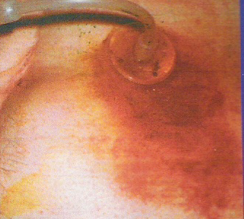
Gastric Leakage
Indications
  Pain, red skin, peristomal leakage, irritation
Causes
  Incorrect position of fixation device
  Stoma has enlarged
  Allergy to tube material
  Delayed gastric emptying
  Constipation
  Buried bumper syndrome

Slide 26
Gastric leakage continued
Treatment
  Test leakage with pH paper
  Ensure correct position of fixation device
  Keep area clean and dry, consider barrier cream/lotion
  If exudate is heavy, consider use of absorbent dressing
  If gastrostomy tube, check internal balloon

Slide 27
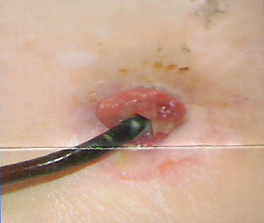
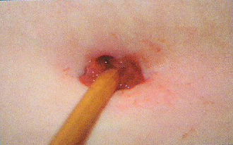
Overgranulation
“An overgrowth of pink, protruding mass of moist tissue at stoma, prone to bleeding”

Slide 28
Overgranulation
Causes
  Excessive movement of gastrostomy tube e.g. Incorrect position of external fixation device
  Fibre particles or trapped moisture at stoma site
  Moisture at site
  Infection
  Delay in healing time- chronic disease, malnutrition, diabetes

Slide 29
Overgranulation
Treatment
  Swab site if indicated
  Ensure correct position of fixation device
  Clean stoma
  Use of a foam dressing eg. Lyofoam
  Topical administration of Inadine, corticosteroid cream, silver nitrate or honey based dressings
  Consider surgical removal

Slide 30
Blocked tubes
Prevention
  Flush before and after administration of feed and medication
  Flush to maintain patency if feeding is discontinued

Slide 31
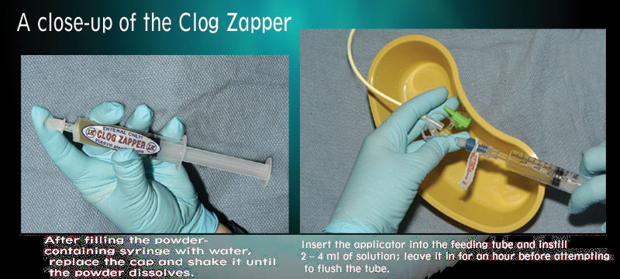
Treatment
  Attempt to flush tube with warm water/soda water
  Use a plunging action to withdraw and insert the tube contents
  Massage the tube, roll between fingers
  Commercial declogging agents are available
  N.B. Fruit juices and cola not recommended

Slide 32
Supplements and Feeds

Slide 33
Fortisip Compact
Per 125ml bottle
300 calories
12g protein
With added fibre
Fortisip Compact Fibre
300 calories
12g protein
4.5g fibre

Slide 34
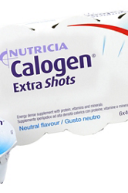
Calogen Extra Shots
Per 40ml
160 calories
2g protein

Slide 35
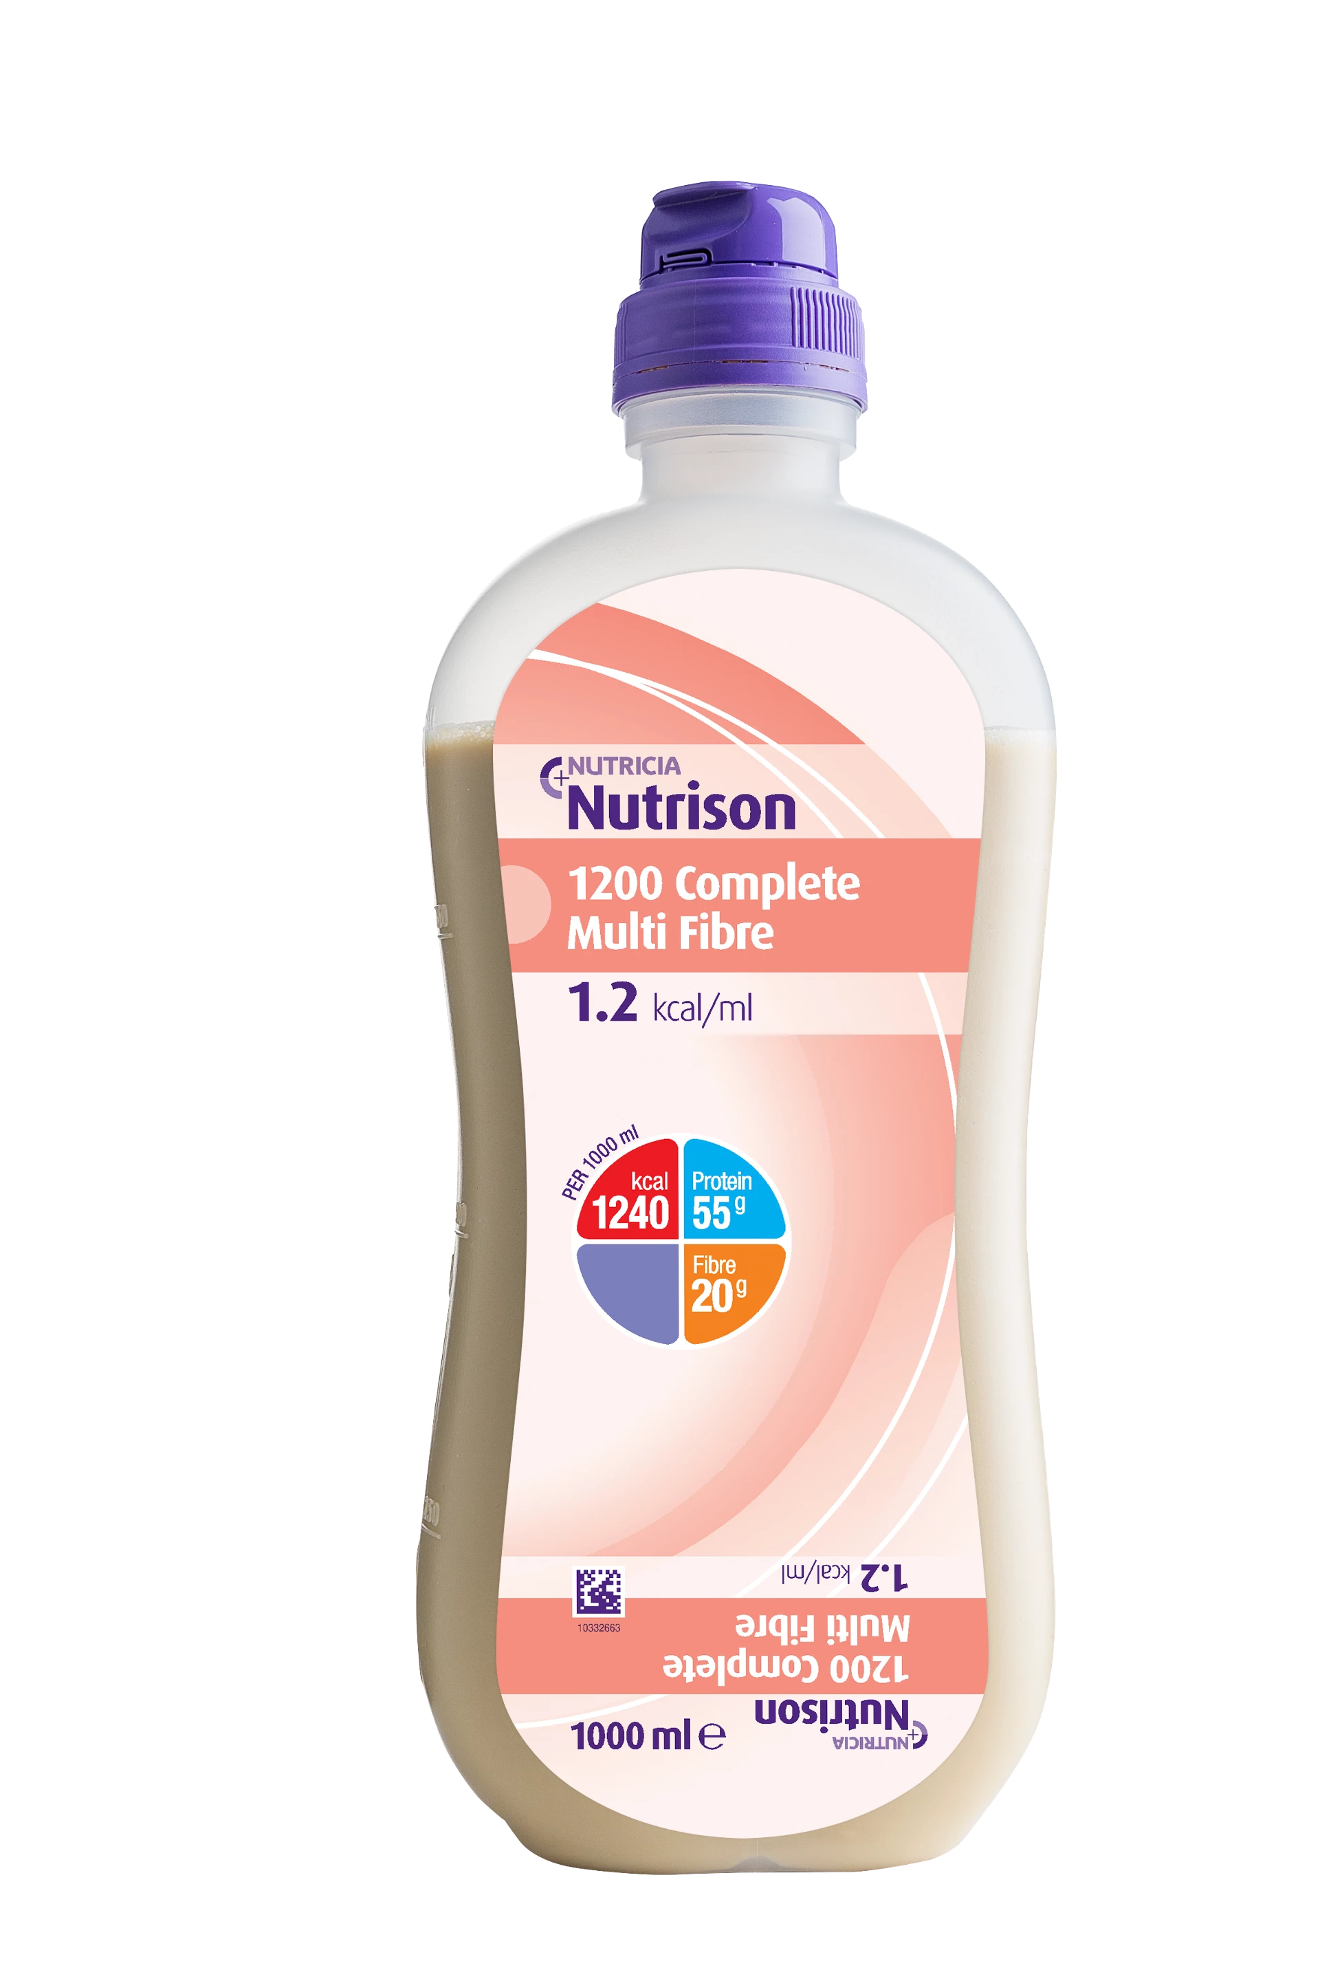
Nutrison 1200 Complete Multifibre
1240 calories
55g protein
20g fibre
Less calories complete in 1000ml
Nutrison 800 Complete Multifibre
Nutrison 1000Complete Multifibre

Slide 36
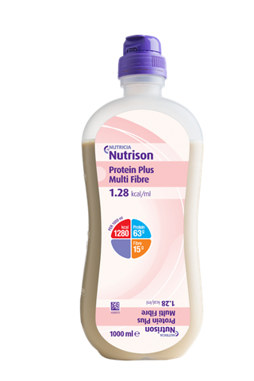
Nutrison Protein Plus Multifibre
1280 calories
63g protein
15g fibre
Also available without fibre
Nutrison Protein Plus

Slide 37

Nutrison Soya
Milk free
1000 calories
40g protein
Also available with fibre
Nutrison Soya Multifibre
15g fibre

Slide 38
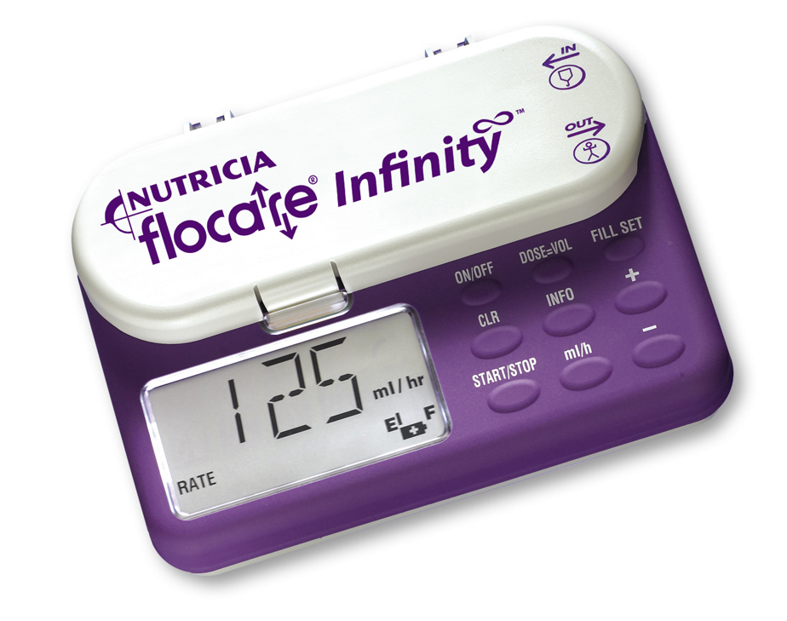
Flocare Infinity Pump

Slide 39
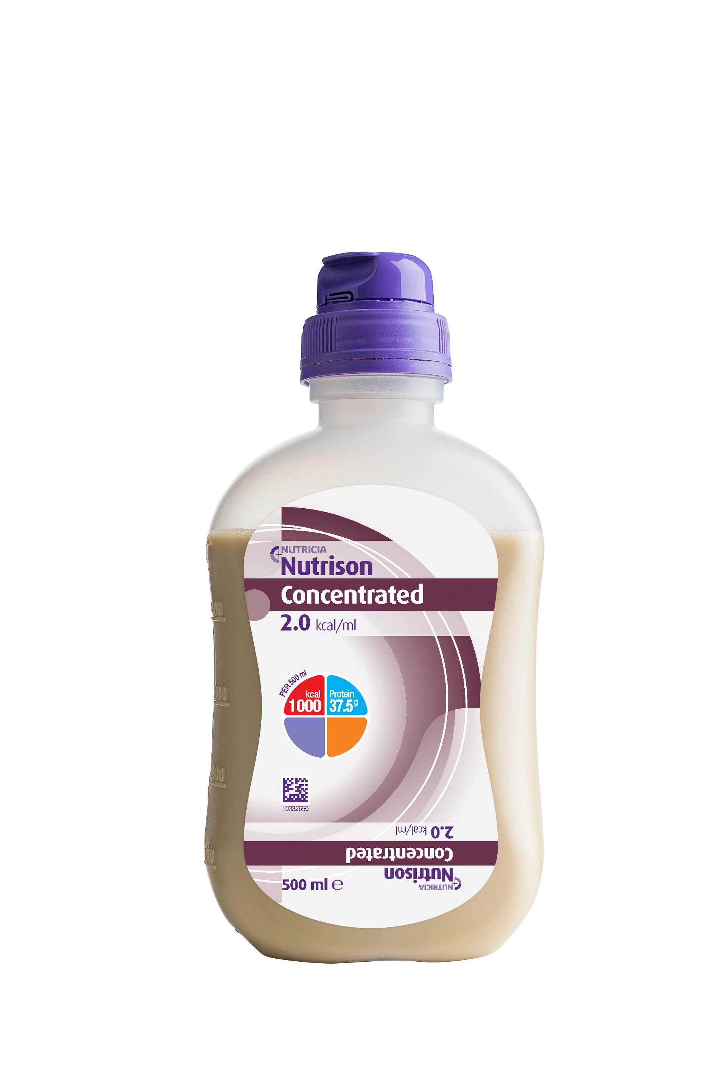
Nutrison Concentrated
2000 calories
75g protein
No fibre

Slide 40

Prosource TF
45ml sachet
11g protein
44 calories
0g fat
1g carbohydrate
Prosoutce Plus
15g protein
100calories
0g fat
11g carbohydrate

